Slide 1
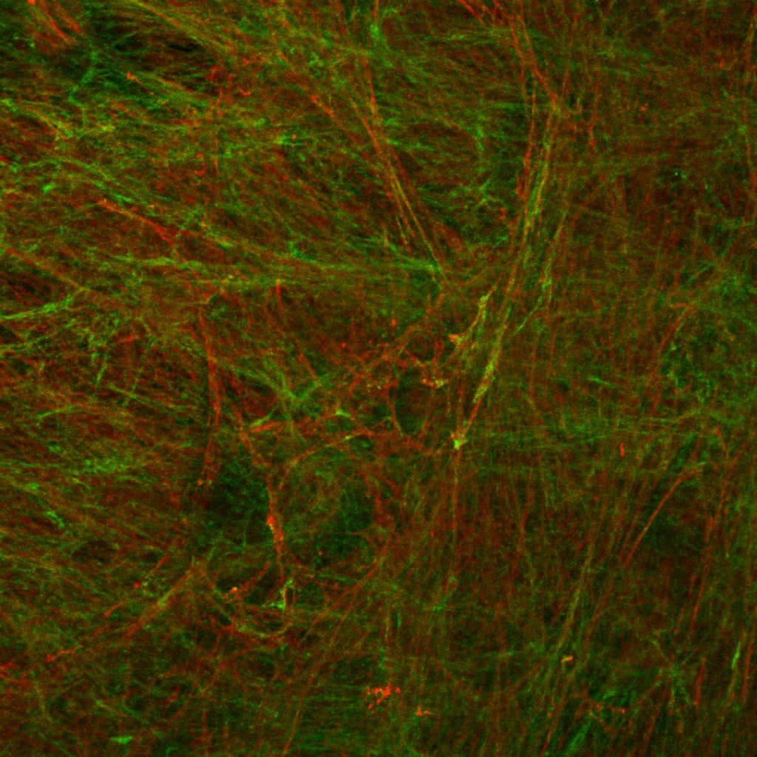
ECM (DP)
FBN COL1
Representative immunofluorescence image of Fibronectin and Collagen 1 expressed in extracellular matrix (ECM) generated by Derma Papilla fibroblasts (DP). Confocal microscope, magnification 63x.

Slide 2
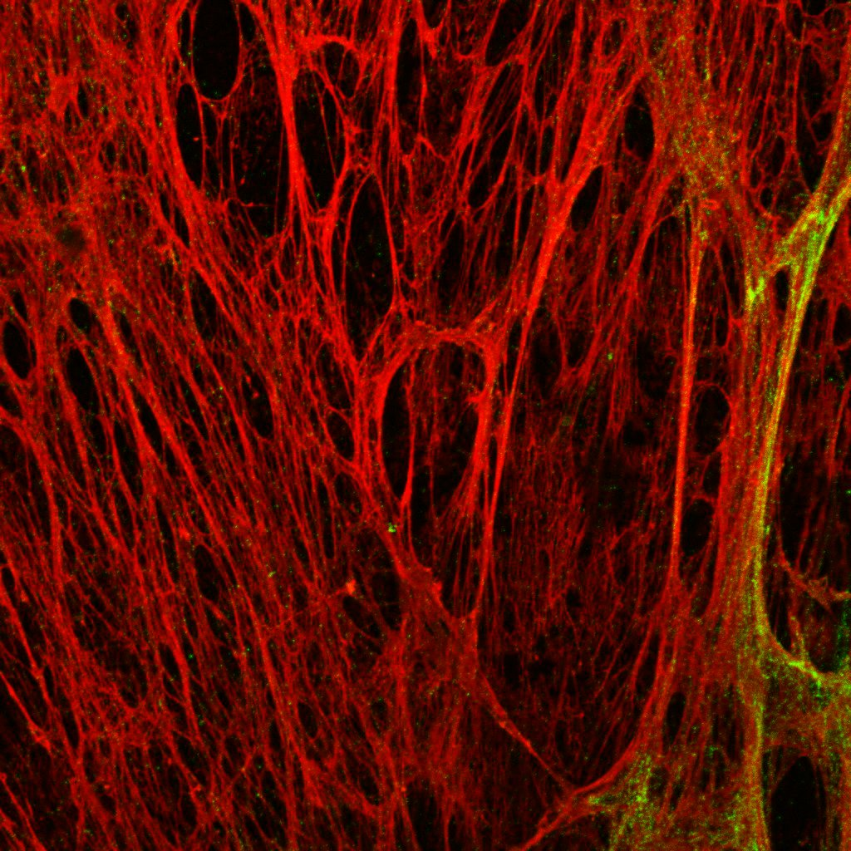
ECM (Pfi)
FBN COL1
Representative immunofluorescence image of Fibronectin and Collagen 1 expressed in extracellular matrix (ECM) generated by Papillary fibroblasts (Pfi). Confocal microscope, magnification 63x.

Slide 3
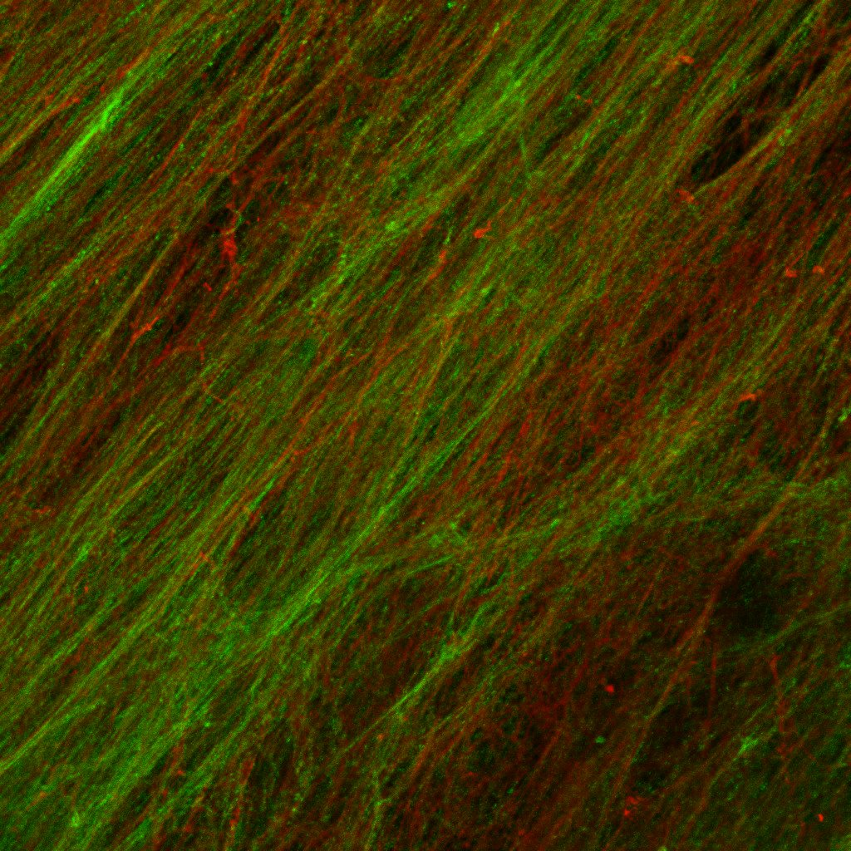
ECM (Rfi)
FBN COL1
Representative immunofluorescence image of Fibronectin and Collagen 1 expressed in extracellular matrix (ECM) generated by Reticular fibroblasts (Rfi). Confocal microscope, magnification 63x.

